Slide 1
JOB PORTAL
MANAGEMENT SYSTEM
MySQL Database Design & Query Implementation
CAPSTONE PROJECT PRESENTATION
Presented by: Sidagam Geethika
S. Revathi

Slide 2
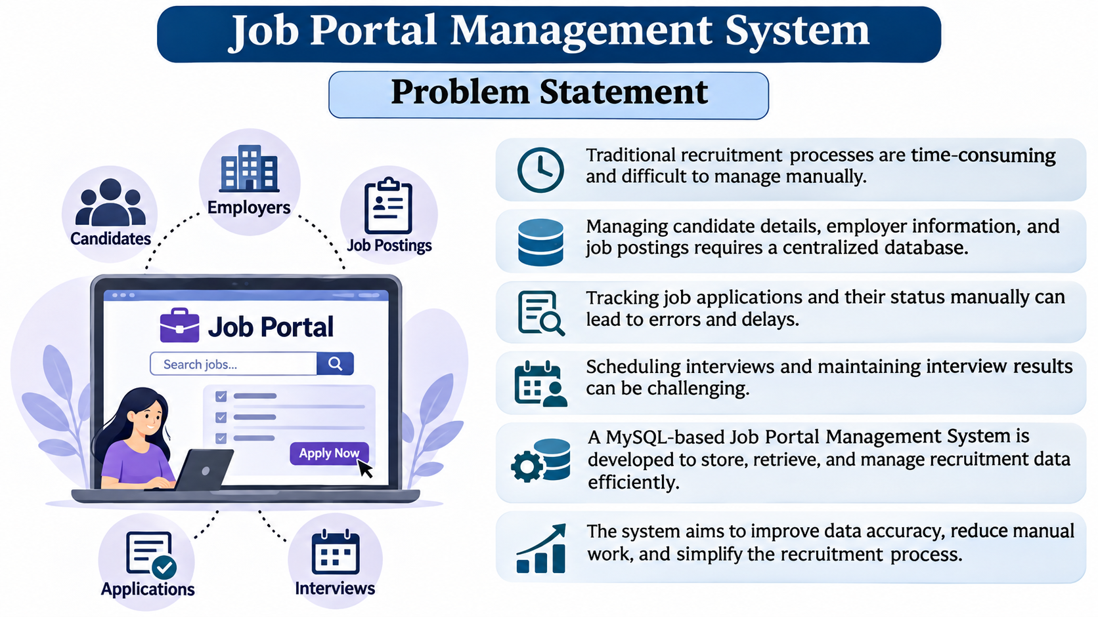
Problem Statement
Project purpose
JOB PORTAL MANAGEMENT SYSTEM • MYSQL CAPSTONE PROJECT
5

Slide 3
Project Objective
Introduction to the Job Portal Management System
The Job Portal Management System is a database project developed using MySQL.
It is designed to manage job seekers, employers, job vacancies, applications and interviews.
It stores candidate details such as name, phone number, email and city.
It maintains employer information, including company names and industries.
It manages job details such as job title, location and salary information.
It tracks candidate applications and their statuses, such as Applied, Shortlisted, Rejected and Selected.
It maintains interview schedules, interview modes and results.
It uses SQL queries to retrieve, filter, update and analyze database records.
It uses joins, aggregate functions, views, stored procedures and triggers to manage data efficiently.
The system provides organized and structured recruitment information for easy management.
JOB PORTAL MANAGEMENT SYSTEM • MYSQL CAPSTONE PROJECT
3

Slide 4
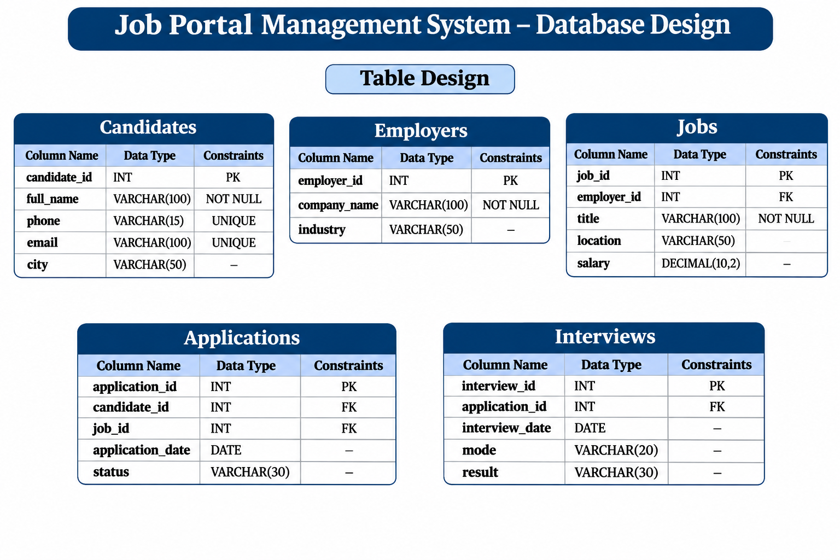
Database Design
JOB PORTAL MANAGEMENT SYSTEM • MYSQL CAPSTONE PROJECT
6

Slide 5
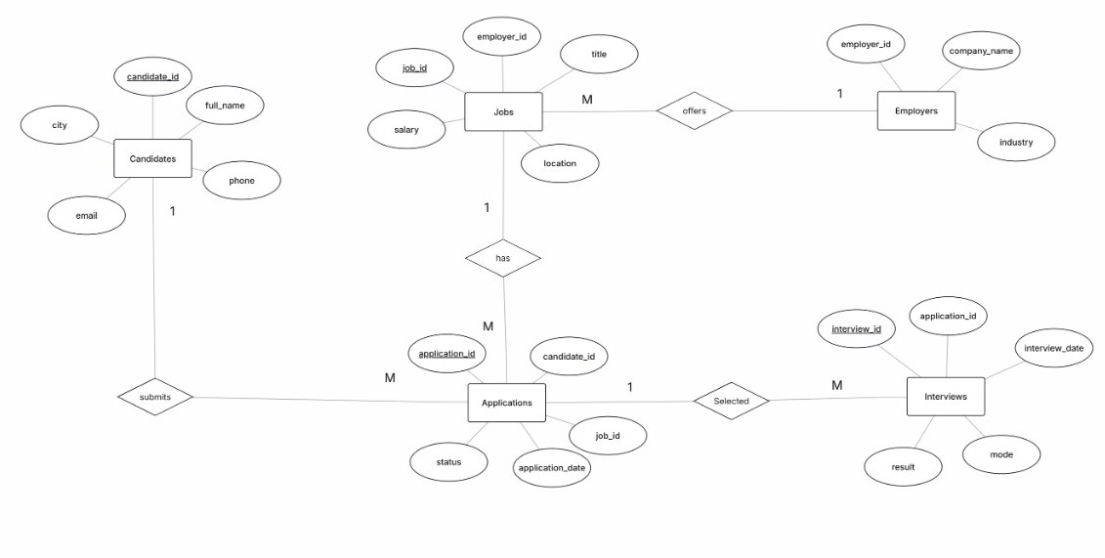
ER Diagram
Relationships: Employers 1—many Jobs | Candidates 1—many Applications | Jobs 1—many Applications | Applications 1—many Interviews
JOB PORTAL MANAGEMENT SYSTEM • MYSQL CAPSTONE PROJECT
7

Slide 6
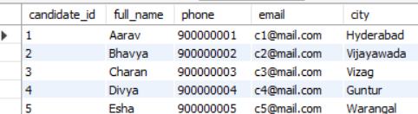
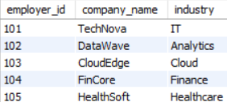
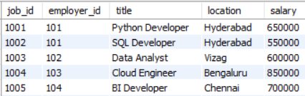
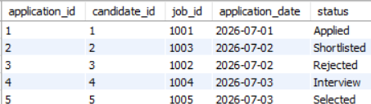
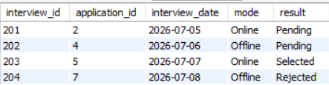
Sample Data – Tables
Records inserted into the five tables
Candidates Table
Employers Table
Jobs Table
Applications Table
Interview Table
JOB PORTAL MANAGEMENT SYSTEM • MYSQL CAPSTONE PROJECT
8

Slide 7

Numeric Functions
Numeric functions are used to perform mathematical calculations and manipulate numerical values in a database Functions such as ABS(), ROUND(), CEIL(), FLOOR(), MOD(), POWER(), SQRT() and TRUNCATE() help calculate and manipulate numbers.
JOB PORTAL MANAGEMENT SYSTEM • MYSQL CAPSTONE PROJECT
8

Slide 8
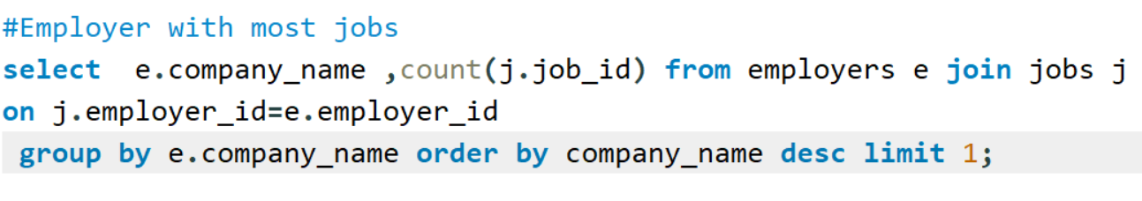

Aggregate Functions
Summaries and calculations
COUNT() counts records, such as applications grouped by status.
SUM() calculates the total salary budget offered by each company.
AVG() calculates average salary by company.
MAX() and MIN() return the highest and lowest salary offered.
GROUP BY groups rows before aggregate calculations; HAVING filters grouped results. ORDER BY Used when we want to arrange records in a particular order
JOB PORTAL MANAGEMENT SYSTEM • MYSQL CAPSTONE PROJECT
9

Slide 9
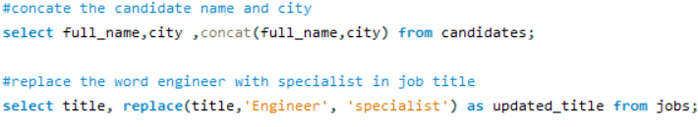
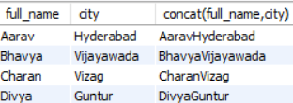
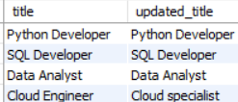
String Functions
SQL string functions are used to manipulate and perform operations on text data.
They are divided into seven categories:
Case Conversion (UPPER(), LOWER()),
Length (LENGTH(), CHAR_LENGTH()),
Extraction (SUBSTRING(), LEFT(), RIGHT()),
Modification (REPLACE(), REVERSE(), INSERT()),
Joining (CONCAT(), CONCAT_WS()),
Trimming (TRIM(), LTRIM(), RTRIM())
Searching (INSTR(), LOCATE(), POSITION()).
These functions help convert, calculate, extract, modify, combine, remove spaces, and search text values in a database.
QUERY SCREENSHOT
OUTPUT SCREENSHOT
Paste screenshot here
Paste screenshot here
Keep query and result visible
Keep query and result visible
JOB PORTAL MANAGEMENT SYSTEM • MYSQL CAPSTONE PROJECT
10

Slide 10
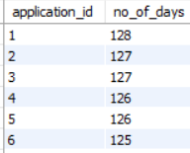
Date Functions
Working with application and interview dates
SQL date functions are divided into six categories:
Current Date and Time (CURDATE(), NOW(), CURTIME()),
Date Extraction (YEAR(), MONTH(), DAY(), DAYNAME(), MONTHNAME()),
Date Formatting (DATE_FORMAT(), TIME_FORMAT()),
Date Calculation (DATEDIFF(), TIMEDIFF(), TIMESTAMPDIFF()),
Date Manipulation (DATE_ADD(), DATE_SUB(), ADDDATE(), SUBDATE(), LAST_DAY())
Date Conversion (STR_TO_DATE(), DATE(), TIME()).
These functions help manage and manipulate date and time values efficiently.
OUTPUT SCREENSHOT
Paste screenshot here
Paste screenshot here
Keep query and result visible
Keep query and result visible
JOB PORTAL MANAGEMENT SYSTEM • MYSQL CAPSTONE PROJECT
11

Slide 11
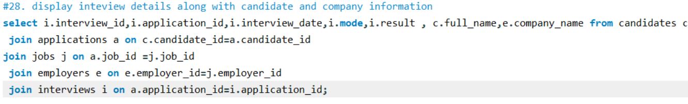

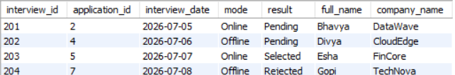
Joins
Combining related information
Joins are used to combine records from two or more tables based on a related column between them.
INNER JOIN: Find candidates who applied for jobs.
LEFT JOIN: Find all candidates, including those without applications.
RIGHT JOIN: Display all applications with candidate details.
FULL OUTER JOIN: Display all candidates and applications.
CROSS JOIN: Generate all candidate-job combinations.
SELF JOIN: Find candidates living in the same city.
JOB PORTAL MANAGEMENT SYSTEM • MYSQL CAPSTONE PROJECT
12

Slide 12
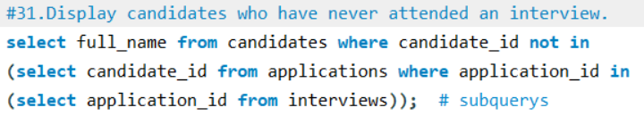

SUB-QUERIES
A Subquery is a query written inside another SQL query. It is also called an inner query or nested query. It is used to retrieve data based on the result of another query.
Single Row Subquery: Returns only one row as the result( =, >, <, >=, <=, <>)
Multiple Row Subquery: Returns more than one row as the result. (IN, NOT IN, ANY, ALL)
Correlated Subquery: Inner query depends on the outer query and executes for each row considered by the outer query.(EXISTS, NOT EXISTS, comparison operators (=, >, <))
Paste screenshot here
OUTPUT SCREENSHOT
JOB PORTAL MANAGEMENT SYSTEM • MYSQL CAPSTONE PROJECT
12

Slide 13
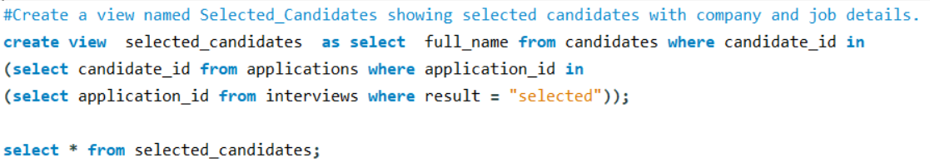

Views
A VIEW is a virtual table created using an SQL query. It displays data from one or more existing tables without storing the data separately.
JOB PORTAL MANAGEMENT SYSTEM • MYSQL CAPSTONE PROJECT
13

Slide 14
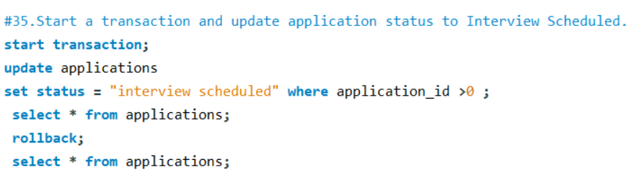
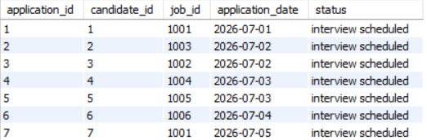
TCL – Transaction Control Language
Managing database transactions
START TRANSACTION / BEGIN starts a transaction.
UPDATE and DELETE demonstrate changes made within a transaction.
ROLLBACK cancels uncommitted changes and restores the earlier state.
COMMIT when a transaction should be permanently saved.
SAVEPOINT Creates a temporary point within a transaction to which we can roll back.
JOB PORTAL MANAGEMENT SYSTEM • MYSQL CAPSTONE PROJECT
14

Slide 15

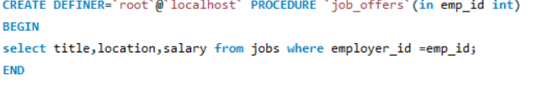
Stored Procedures
A Stored Procedure is a collection of SQL statements stored in the database and executed whenever required. It helps reuse SQL code and reduces repeated work.
Without Parameters: Executes SQL statements without taking any input.
IN Parameter: Accepts input values from the user.
OUT Parameter: Returns output values from the procedure.
INOUT Parameter: Accepts input and returns a modified value.
Keywords: CREATE PROCEDURE, IN, OUT, INOUT, CALL, DROP PROCEDURE.
QUERY SCREENSHOT
Paste screenshot here
Keep query and result visible
JOB PORTAL MANAGEMENT SYSTEM • MYSQL CAPSTONE PROJECT
15

Slide 16
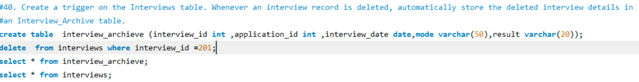

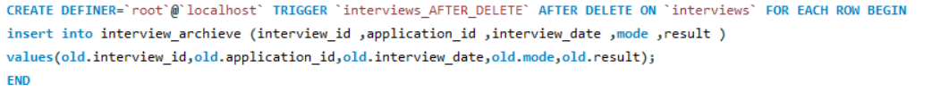
Triggers
A Trigger is a special stored program that automatically executes when a specific event occurs on a table.
Triggers are classified into six types:
BEFORE INSERT: Before inserting a record.
AFTER INSERT: After inserting a record.
BEFORE UPDATE: Before updating a record.
AFTER UPDATE: After updating a record.
BEFORE DELETE: Before deleting a record.
AFTER DELETE: After deleting a record.
QUERY SCREENSHOT
Paste screenshot here
Keep query and result visible
JOB PORTAL MANAGEMENT SYSTEM • MYSQL CAPSTONE PROJECT
16

Slide 17
Conclusion
Designed a relational MySQL database for a job portal using five connected tables.
Inserted sample data for candidates, employers, jobs, applications and interviews.
The Job Portal Management System was successfully designed and implemented using MySQL.
Five relational tables were created to manage candidates, employers, jobs, applications and interviews.
Primary Keys and Foreign Keys were used to establish relationships between tables.
SQL queries were implemented to insert, retrieve, update and manage records.
String, date, aggregate functions and JOIN operations were used to extract meaningful information.
Views, Stored Procedures and Triggers were used to simplify database operations and automate tasks.
TCL commands such as COMMIT and ROLLBACK were used to manage transactions.
The project provides an organized and efficient way to handle recruitment-related information.
Overall, this project demonstrates the practical application of MySQL concepts in developing a structured and efficient Job Portal Management System.
JOB PORTAL MANAGEMENT SYSTEM • MYSQL CAPSTONE PROJECT
18

